Slide 1
Capstone Project
Yes Bank Stock Price Prediction
By Rishekh Dubey

Slide 2
Points for discussion
Loading the data
Cleaning the data
Exploratory data analysis
Train- Test Split analysis
Conclusion

Slide 3
Data Summary
Problem Statement
Yes Bank is a well-known bank in the Indian financial domain. Since 2018, it has been in the news because of the fraud case involving Rana Kapoor.
Owing to this fact, it was interesting to see how that impacted the stock prices of the company and whether Time series models or any other predictive models can do justice to such situations.
This dataset has monthly stock prices of the bank since its inception and includes closing, starting, highest, and lowest stock prices of every month.

Slide 4
Business Goal
We are required to build a model to predict the stock closing price of the month with the available dataset.
Dataset
We created a directorial path for the Yes Bank dataset, using the Pandas read function we read it. It has a shape (185, 5) which means it has 185-row labels and 5 features or column labels.

Slide 5
Data Cleaning
We can see that there are multiple data which doesn’t contain any value, the data which doesn’t contain any value is called null value. We also have outliers in our dataset.
As our dataset contain multiple null values so in order to replace the null values we have used fill na method so that we can get better result.

Slide 6
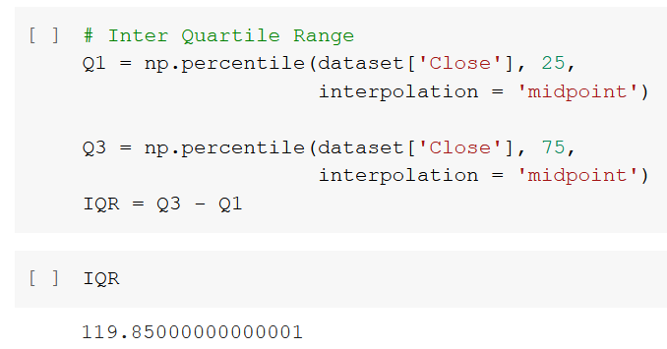
To remove outliers we have plotted the box plot to locate the outliers and then we have used IQR-based filtering (Inter Quartile Range) to remove the outliers from our data set.

Slide 7
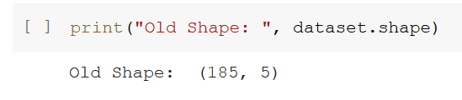
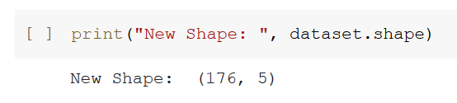
Shape of the dataset before IQR Filtering
Shape of the dataset after IQR Filtering

Slide 8
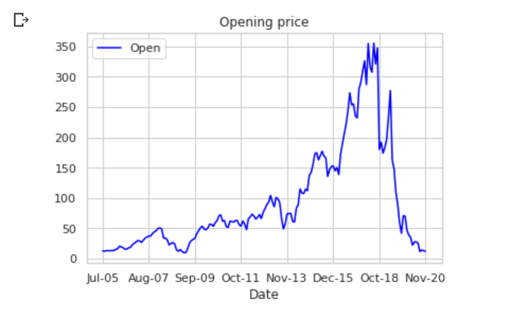
Opening stock prices
This line plot indicates the opening stock prices and we can see that highest opening stock price was 369 between December 2015 to October 2018. However, after the fraud case, the stock opening price has been spontaneously dropped.

Slide 9
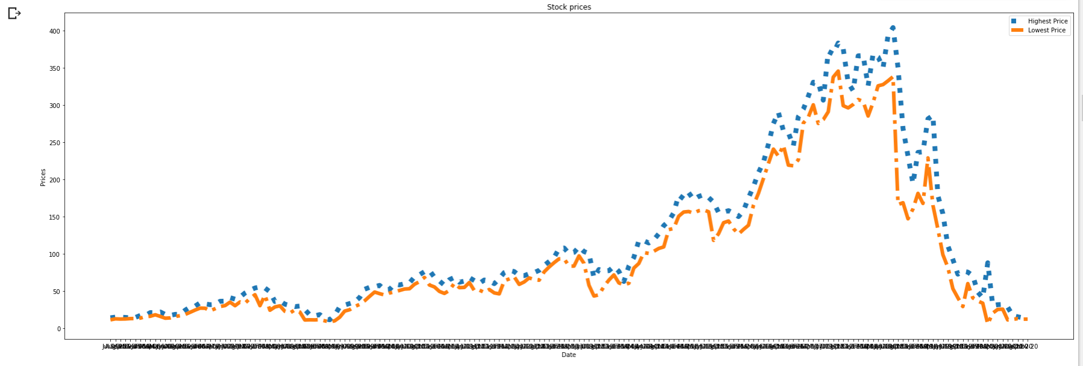
Highest and lowest prices of the stock:-
The blue line shows the highest stock prices over the period and the orange line shows the lowest stock prices over the period.

Slide 10
Stock closing prices
We can see that the average stock price was 94.94 and the maximum price was 345.
At first, the closing price was increasing gradually but after 2019 we can see that the closing price didn’t cross 50 marks and it keep getting dropped.

Slide 11
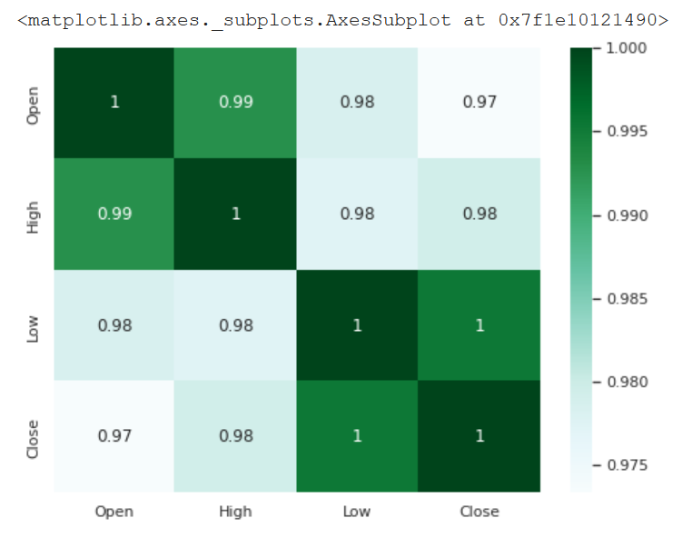
Correlation
This is a heatmap chart that represents the relation between one feature and another one.
By plotting seaborn heatmap correlation we got to know that there features positively correlated with each other.

Slide 12
A correlation value can be positive, negative, or neutral/zero. Where positive refers to that both the variables move in the same direction, negative shows that one variable’s value increases, the other variables’ values decrease. Neutral/zero means that variables are unrelated to each other.
We can see that values of the Close and Low variables are highly positively correlated and the Open and close are less correlated as compared to other variables.

Slide 13
Standardization:-
We have standardized our dataset so that all the variables get equal importance it's like rescaling the values so that all the variable doesn’t greatly differ from each other.
We have used standardscaler, the idea behind StandardScaler is that it will transform your data such that its distribution will have a mean value of 0 and standard deviation of 1

Slide 14
Train and Test Analysis:-
The train-test split is used to estimate the performance of machine learning algorithms that are applicable for prediction-based Algorithms/Applications.
This method is a fast and easy procedure to perform such that we can compare our own machine learning model results to machine results.

Slide 15
In this analysis, we divide the dataset into two data subsets. The first subset is used to fit the model which is called the training dataset. Then the second subset is used for prediction as compared to expected values this is called the testing dataset.
We have used train data as 80% and test data as 20%. Scikit-learn alias sklearn is the most useful and robust library for machine learning in Python.

Slide 16
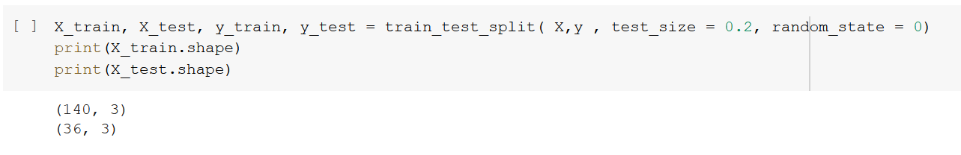
Here, X, is our independent variable and y is our dependent variable. Test size=0.2 specify that only 20% of the dataset is used for the test data set. The random state gives us the random split every time.

Slide 17
In the “reg” variable we have stored the linear regression calculation. Sklearn is extremely straightforward it allows us to implement linear regression directly by importing the LinearRegression class.

Slide 18
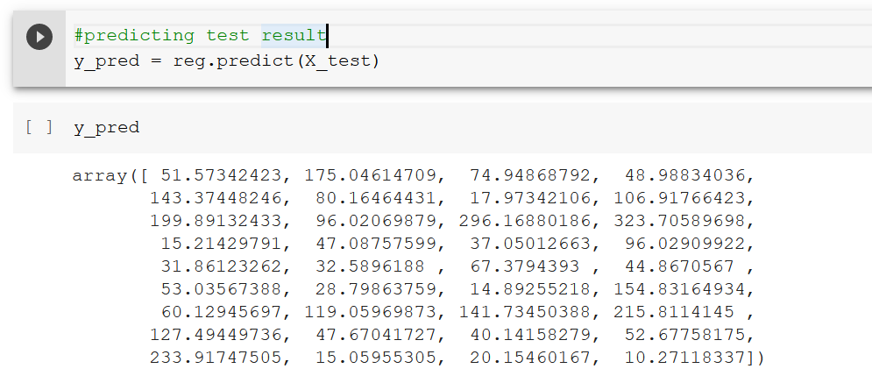
We have stored all the predicted values for the input values of the X_test series in “y_pred”.

Slide 19
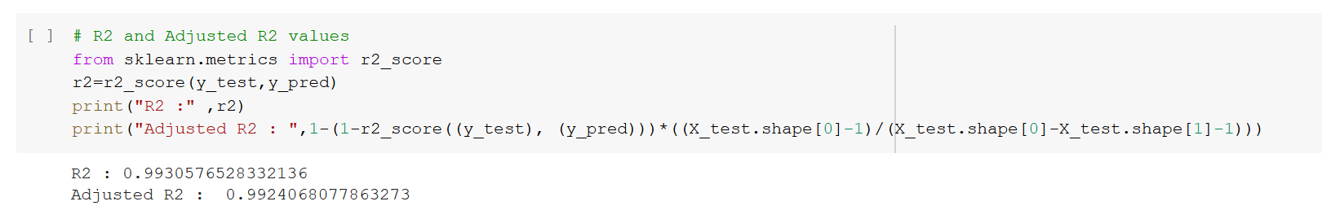
R2 and Adjusted R2:-

Slide 20
R² score is used to evaluate the performance of a linear regression model. It is the amount of the variation in the output dependent attribute which is predictable from the input independent variable(s).
Adjusted r-square is a modified form of r-square whose value increases if new predictors tend to improve the model’s performance and decreases if new predictors do not improve performance as expected.

Slide 21
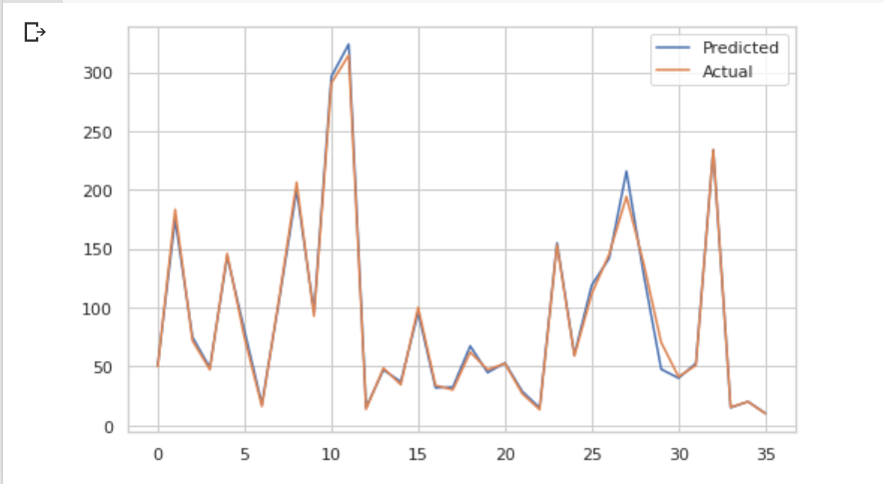
Conclusion:-

Slide 22
After applying train test split analysis and plotting the graph we can see that the error between the predicted and actual value is minimum which means our model prediction values is as good as the actual values.
As we can see from the value of R2 and Adjusted R2 it proves that our model is predicting the stock closing price very efficiently.

Slide 23
References
Geeks for Geeks
Analytics Vidhya

Slide 24
Thank You !!

